Slide 1


HAZOP Modelling
Using Machine Learning

Slide 2

Introduction
HAZOP is a systematic hazard identification methodology for determining the causes and consequences of deviations of process variables (flow, pressure, temperature etc..) from design intent.
HAZOP analysis offers the potential for improved efficiency and effectiveness in identifying hazards, analyzing risks, and implementing appropriate control measures.

Slide 3

What is HAZOP?
HAZOP (Hazard and operability Study ) is a systematic, structured and team-based approach to identify potential hazards and operability issues in industrial processes. It has no motive to replace humans but it is for to reduce the amount of time required for human.
It is based on the principle that a plant is HAZOPed by
expert team during development at regular intervals.

Slide 4
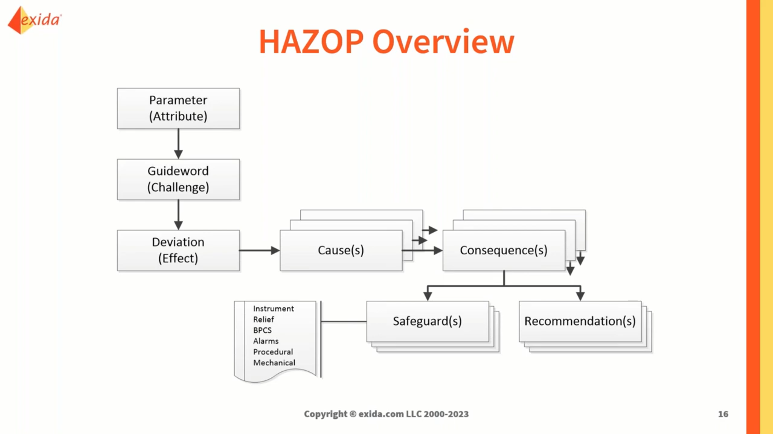

Slide 5
System Components
AutoHAZID – This module performs identification on pre-defined process plant description.
Graphical Tool- It is a GUI which enables you to specify process plant.It is developed by TXT.
Unit Model Library- It conatins models of every type of process unit which is represented by HAZID.
Model Creation Tool- It is not possible that unit model library contains all units. So it is good that user can create the unit models within HAZID.

Slide 6
AUTOHAZID
A process plant description is subjected to hazard identification using the AutoHAZID module. AutoHAZID produces an SDG representation of a process plant using the process data that is recorded in the HAZID database. The analysis by AuioHAZID is based on this SDG representation. techniques

Slide 7
The main objective of HAZID's development is to mimic the HAZOP analytical method. By applying HAZOP deviations and tracking the effects along the graph to find the sources and effects of the deviations, HAZID conducts a hazard analysis on a sign directed graph (SDG) representation of a process plant. The SDG format has been modified to incorporate coded arcs, allowing a more detailed specification of relationships between variables.
HAZID is being developed in conjunction with a number of industrial companies whose safety experts have been closely involved in both the knowledge acquisition and output validation stages of the project.

Slide 8
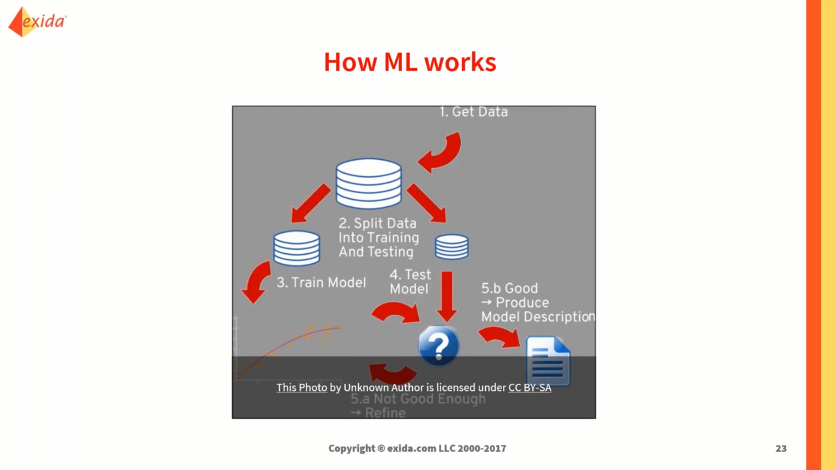

Slide 9
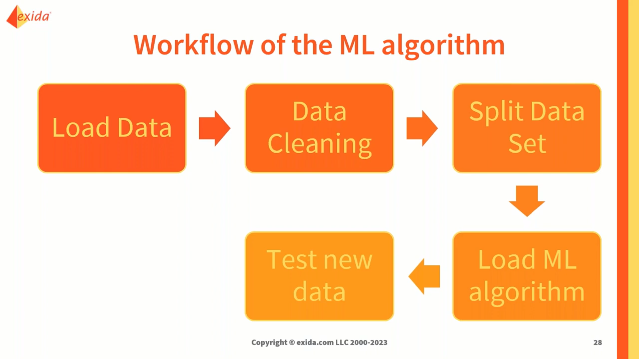
Conclusion
Machine learning-powered HAZOP modelling has the potential to revolutionize process safety management, improving the accuracy and efﬁciency of risk assessments and reducing the risk of accidents in the workplace. It is an exciting area of research and development that promises to make our workplaces safer and more productive.

Slide 10

How Machine Learning Can Improve HAZOP
By applying machine learning to HAZOP modelling, we can improve the accuracy and efﬁciency of the process. Machine learning algorithms can analyze large amounts of data and identify patterns and correlations that would be difﬁcult for humans to detect. This can lead to more comprehensive risk assessments and better decision-making.

Slide 11
Steps to Apply ML Algorithms
# Step 1: Load the dataset
# Step 2: Split the data into training and testing sets
# Step 3: Train the machine learning model
# Step 4: Make predictions on the testing set
# Step 5: Evaluate the model

Slide 12
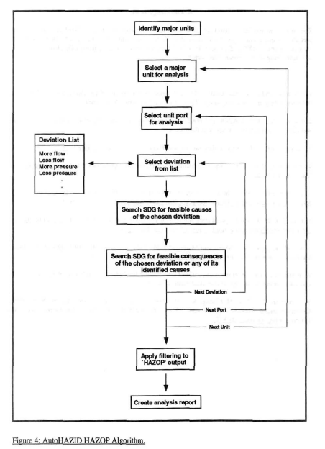
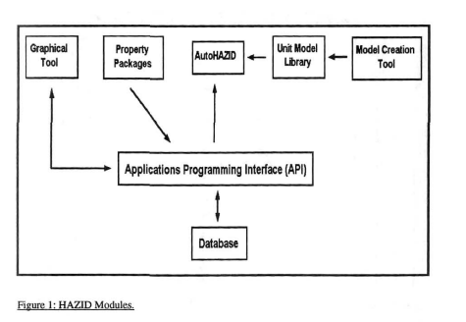

Slide 13
Conclusion
Machine learning-powered HAZOP modelling has the potential to revolutionize process safety management, improving the accuracy and efﬁciency of risk assessments and reducing the risk of accidents in the workplace. It is an exciting area of research and development that promises to make our workplaces safer and more productive.

